Slide 1
One Public Transport System for Cornwall
Project Details
Glyn Williams & David Edwards
Integrated Transport and Technology
Version 3.2

Slide 2
One Public Transport System for Cornwall (OPTSfC)
The One Public Transport System for Cornwall (OPTSfC) has been identified as one of the key deliverables under the “Cornwall Devolution Deal”. The significant aim of this project is to deliver and provide a fully integrated and sustainable public transport network, following the devolution of bus powers under a new Bus Services Bill currently going through the parliamentary process.
The key drivers or objectives of the project are:
To provide an Integrated Public Transport System by December 2018 to coincide with the start of the half hourly mainline service in Cornwall (part of the new rail franchise);
To provide integrated smart ticketing, fares and timetables to deliver combined travel between bus, rail and ferry services for passengers in Cornwall, and air where achievable;
To provide a high quality, accessible and integrated public transport network, developed to increase patronage on bus and rail and bring about an upturn in revenue income and service sustainability.
Notes:
As you will notice the key theme or focus of these outcomes is Integration and this increase the complexity as this means Rail, Bus, Ferry and eventually.
To provide an Integrated Public Transport System by December 2018 to coincide with the start of the half hourly mainline service in Cornwall (part of the new rail franchise);
To provide integrated smart ticketing, fares and timetables to deliver combined travel between bus, rail and ferry services for passengers in Cornwall, and air where achievable;
To provide a high quality, accessible and integrated public transport network, developed to increase patronage on bus and rail and bring about an upturn in revenue income and service sustainability.
So how are approaching this and where we to date?
<CLICK NEW SLIDE>

Slide 3
PUBLIC TRANSPORT
TRAIN SERVICES
Notes:
There are essential 2 options to the Bus Services Bill, “FRANCHISING” and “ENHANCED PARTNERSHIPS”
There are also some useful tools in the available in the Bill.
<CLICK> Lets take a look option 1 – FRANCHISING POWERS – This allows the Local Authority opportunity to take a TFL style approach, dictating how services which are currently Commercial are operated.
The Benefits are clear and allows you to dictate:
which bus services run and when;
the types of ticket available;
the fares that should be charged;
the types of payment that must be accepted;
the information that is available to passengers; and
the standard of bus that must be used – including their emissions standards or fuel technologies, something which will have a greater impact over time
<CLICK NEW SLIDE>

Slide 4
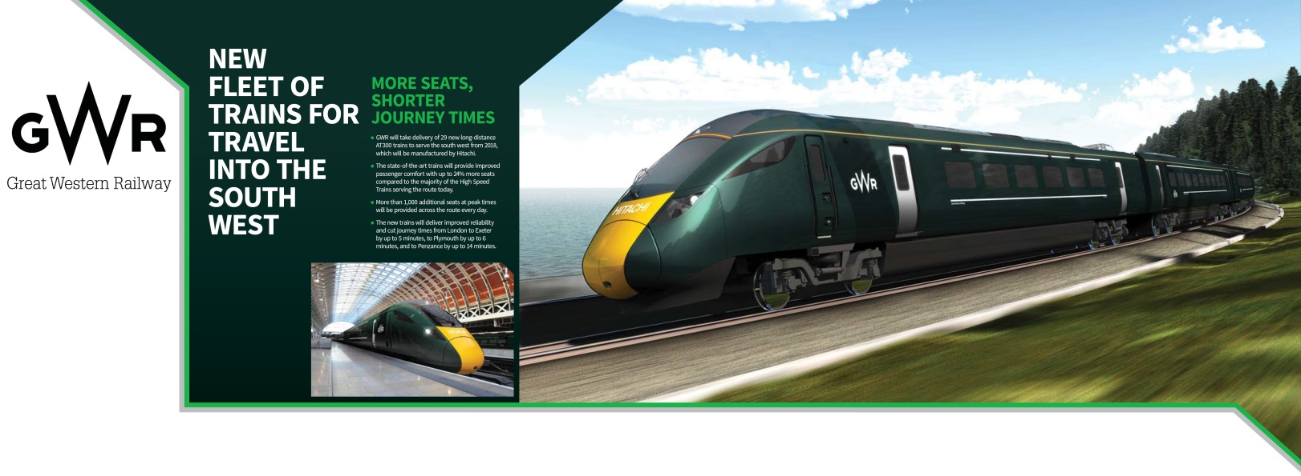
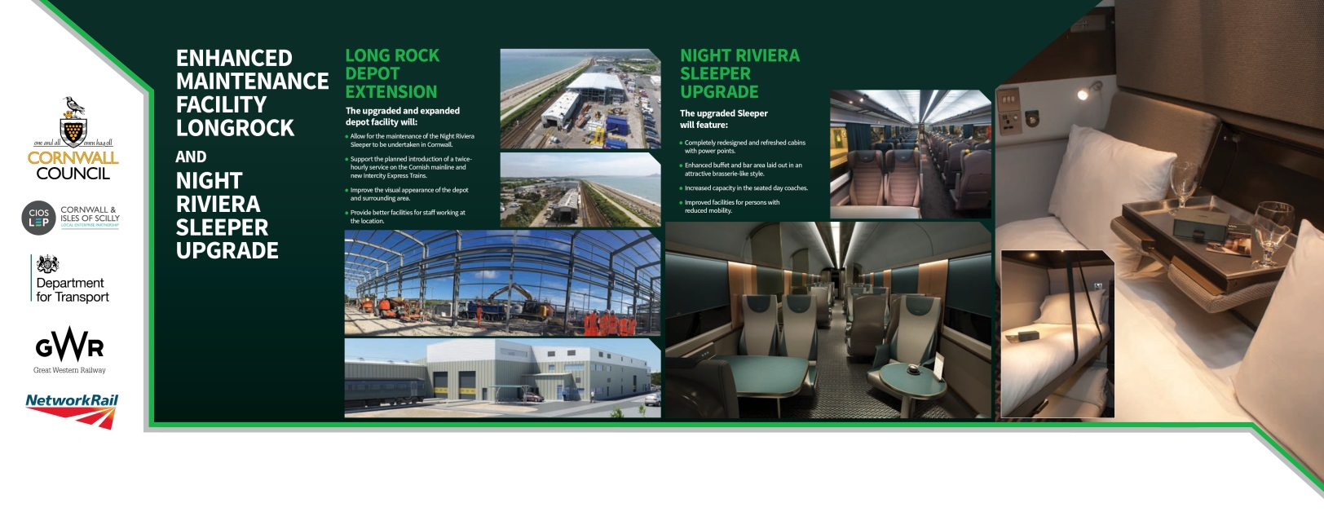
OPTSfC – Rail Investments
Upgraded Sleeper Service
New state-of-the-art new maintenance facility at Long Rock, Penzance
Mainline service enhancements and signaling upgrade
New half-hourly pulse train running from Penzance to Plymouth

Slide 5
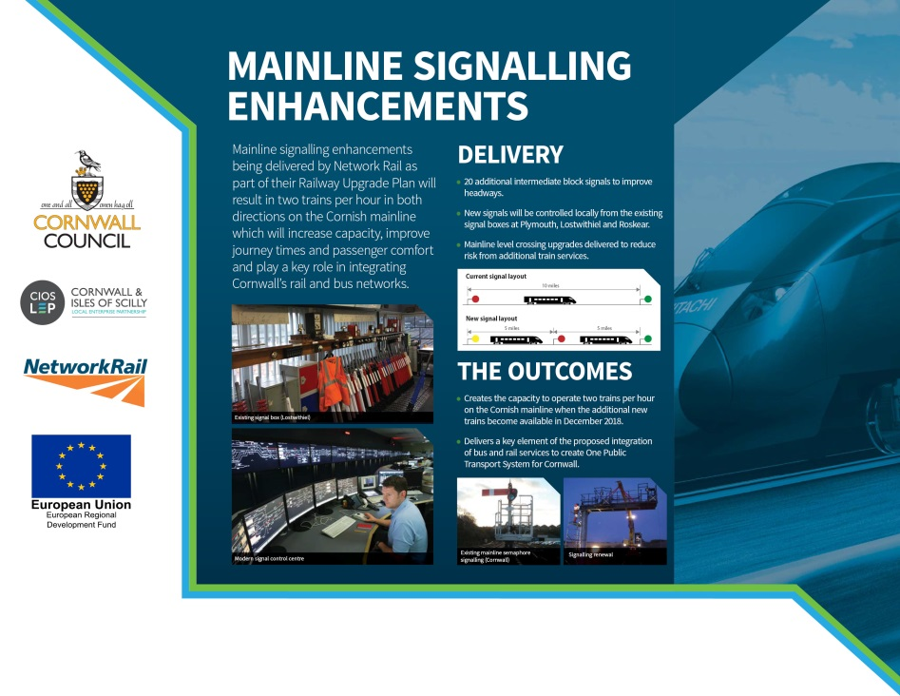
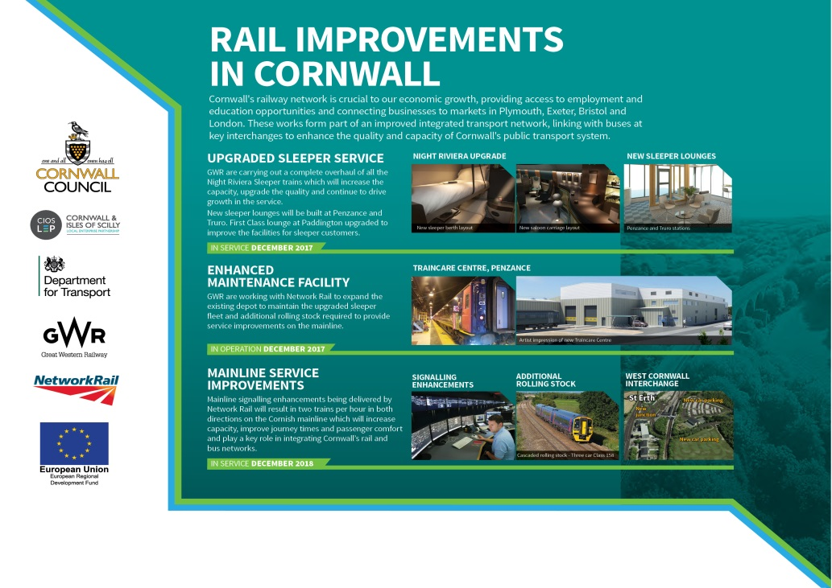
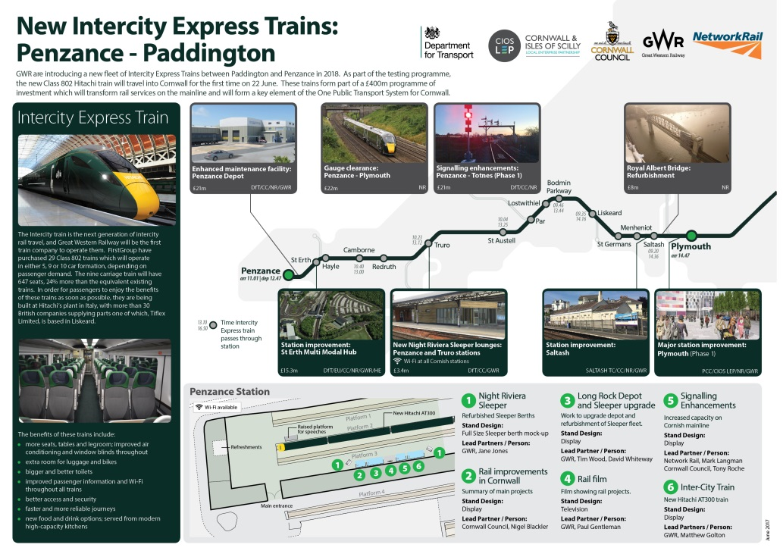

Slide 6
PUBLIC TRANSPORT
BUS SERVICES
Notes:
There are essential 2 options to the Bus Services Bill, “FRANCHISING” and “ENHANCED PARTNERSHIPS”
There are also some useful tools in the available in the Bill.
<CLICK> Lets take a look option 1 – FRANCHISING POWERS – This allows the Local Authority opportunity to take a TFL style approach, dictating how services which are currently Commercial are operated.
The Benefits are clear and allows you to dictate:
which bus services run and when;
the types of ticket available;
the fares that should be charged;
the types of payment that must be accepted;
the information that is available to passengers; and
the standard of bus that must be used – including their emissions standards or fuel technologies, something which will have a greater impact over time
<CLICK NEW SLIDE>

Slide 7
Bus Services Bill – What’s it all about?
Franchising Powers
Allows Local Authorities to determine and specify the local bus services that should be provided in their area, including those which are currently operated commercially.
Benefit: which bus services run and when; the types of ticket available; the fares that should be charged; the types of payment that must be accepted; the information that is available to passengers; and the standard of bus that must be used – including their emissions standards or fuel technologies.
Notes:
There are essential 2 options to the Bus Services Bill, “FRANCHISING” and “ENHANCED PARTNERSHIPS”
There are also some useful tools in the available in the Bill.
<CLICK> Lets take a look option 1 – FRANCHISING POWERS – This allows the Local Authority opportunity to take a TFL style approach, dictating how services which are currently Commercial are operated.
The Benefits are clear and allows you to dictate:
which bus services run and when;
the types of ticket available;
the fares that should be charged;
the types of payment that must be accepted;
the information that is available to passengers; and
the standard of bus that must be used – including their emissions standards or fuel technologies, something which will have a greater impact over time
<CLICK NEW SLIDE>

Slide 8
Bus Services Bill – What’s it all about?
Enhanced Partnership Powers
Allows Local Authorities and bus operators to work together to set out and deliver improvements to local bus services in the area. Through partnership working, Authorities and Operators can agree standards for local bus services – including vehicle specifications, branding, ticketing and service frequencies.
Benefit: Opportunity for LA and bus operators to work together to identify the bus services needed in an area, including thinking about the best mix of services to meet the needs of passengers throughout the area, including in rural communities; Opportunity to determine the optimum network of services for the area, and it may be that there are efficiency savings that could be made, or a re-deployment of existing resources;
Other modes of travel available to deliver connecting journeys Taxi Services
Demand Responsive including Community Transport
Notes:
<CLICK> Now lets take a look option 2 – ENHANCED PARTNERSHIPS – This is more akin to the way a lot of other contracts are set up and operated for services such as Highways etc.
Essentially Enhanced Partnership is as shown on the slide, and it shows that there is focus on working together to agree minimum standards. LA and Operators parties SHOULD work together to decide things such as including vehicle specifications, branding, ticketing and service frequencies.
This has and remains the current favored approach by Cornwall on the One Public Transport System and to support this approach a Steering Group is in operation where both operators, passenger forum representatives and officers have the opportunity to shape the future service.
Other Tool are shown on the slide, Community Transport and/or Demand Responsive
<CLICK NEW SLIDE>
<CLICK NEW SLIDE>

Slide 9
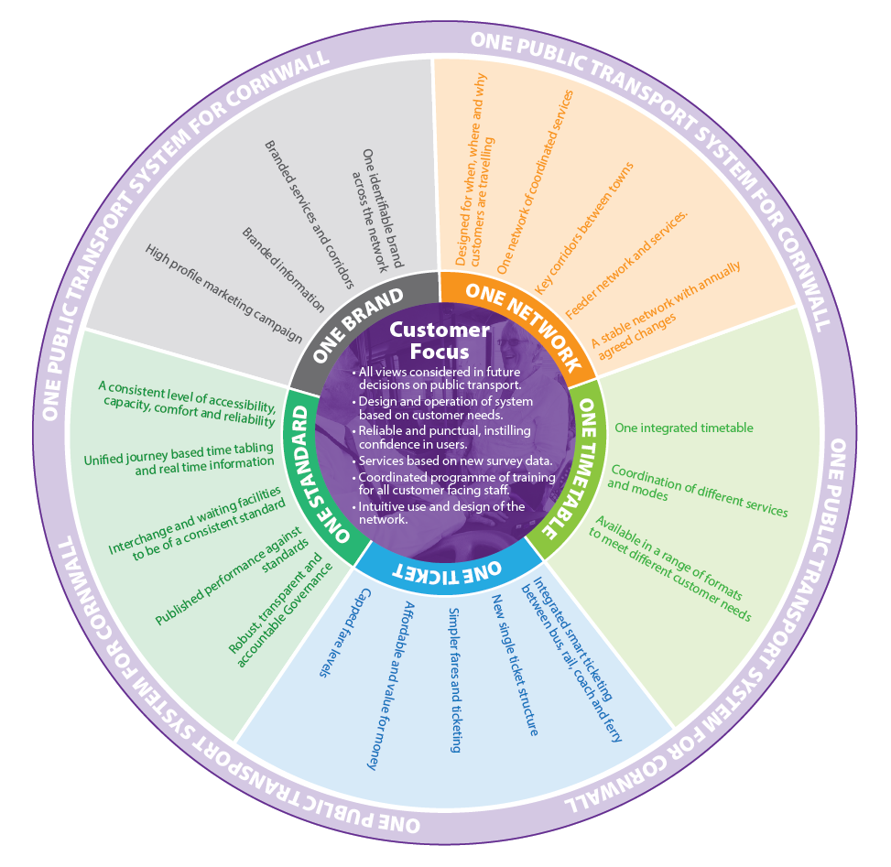
OPTSfC – Elements and Workstreams
Elements or Workstreams:
One Network
One Timetable
One Ticket
One Standard
One Brand
Notes:
So What is the One Public Transport System for Cornwall, it is made up of a number of elements ……
Elements or Workstreams in other words the “Parts of the Puzzle” are:
<CLICK>
One Network
One Timetable
One Ticket
One Standard
One Brand
Now lets look at the Individual elements.
<CLICK NEXT SLIDE>

Slide 10
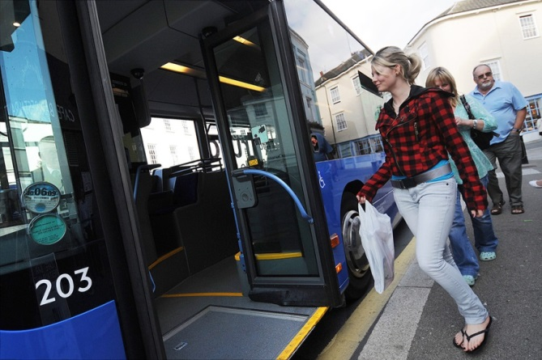
OPTSfC – Principles
Customer focus is at the heart of delivering OPTSfC for bus & rail.
Improved appeal of public transport
Increased patronage to improve the financial viability of the network
OPTSfC will deliver:
  New vehicles
  Improved infrastructure
  Smart ticketing
  Real Time Passenger
  Information
  Image & branding
Notes:
Aim
We want to put the customer at the heart of the public transport system and deliver a public transport service that appeals to existing users and non users. We want to make specific improvements to the delivery and experience of public transport that will increase public transport patronage on bus & rail and bring about an upturn in revenue to make services more financially viable.
We aim to deliver improvements to: vehicles, infrastructure, integration, information, ticketing and branding by Dec 2018 to take advantage of the timing of the 2 trains per hour on the mainline that are being delivered through the rail franchise, sleeper train improvements and the delivery of the maintenance facility at Long Rock.

Slide 11
OPTSfC – Governance, Funding, Timeline
Governance
2015 – Part of Devolution Deal is to pursue improvements to public transport.
Bus Services Bill will give choice of Franchising or Enhanced Partnership Working.
Funding
2015 – £8m Growth Deal 1 funding matched £2.375m from Local Transport Plan for transport improvements
2016 – £10.4m Operator Fleet Investment 37 new buses
2016 – bid for Growth Deal 3 funding to roll out improvements across Cornwall – Amount TBC
DfT Fund Bid - £2m Contactless ticketing
PA07 Bid - £4m Alternative Fuel Infrastructure
Timeline
December 2018 to coincide with enhanced rail service and improvements
Notes:
Funding
In 2015 Cornwall was awarded £8m Growth Deal 1 funding to match against £2.375m from the Local Transport Plan to deliver improvements to public transport (improvements to corridors, infrastructure, vehicles, information, ticketing and branding).
In 2016 Cornwall Council submitted a bid to the LEP for £17.6m Growth Deal 3 funding in order to be able to roll out the public transport improvements being trialled with the GD1 funding across the county. While we are aware that are only now likely to be awarded a significantly smaller sum of money from this GW round, we are still awaiting final confirmation of what this will be.
Governance
In 2015 Cornwall successfully negotiated a Devolution Deal with Government to be granted the powers to Franchise the bus network, thereby taking more control in the delivery of bus services, subject to the passing of the Bus Services Bill. In agreeing to the Deal, Cornwall committed to:
Deliver smart integrated ticketing;
Setting & meeting targets for patronage; and
Put in place robust, transparent & accountable governance arrangements
These funding and governance opportunities are being combined to ensure that the benefits of each are felt as widely as possible and with more impact than if they were delivered separately.
CC Cabinet endorsed work on both franchising and enhanced partnership delivery options. The decision on the preferred option has been deferred until the Bus Services Bill is finalised and further analysis has been conducted into the options. CC will work with operators to deliver the outcomes in partnership. If the partnership is unable to deliver the outcomes CC will take up the franchising powers. CC will continue, in parallel with partnerships, to undertake due diligence on impacts & benefits of franchising. Cabinet will decide if ultimately we pursue partnership or franchising.

Slide 12
OPTSfC – Progress To Date
Steering Group established
Reporting mechanisms established – internal to Council; external to the Local Transport Board, Local Enterprise Partnership and Central Government
Develop Evidence Base
Network & service review
Infrastructure audit
Market research – user satisfaction surveys
Socio-demographic profile – bus users
On-bus Origin & Destination surveys
Development of web/GIS portal
Bus Network Plan – underway
Notes:
A project Steering Group has been established and consists of representatives of:
Bus operators (commercial and SME)
Rail operator
Transport Focus
Local Transport Board
Cornwall Council
We have also established reporting mechanisms with the PAC, Cabinet, Local Transport Board, Local Enterprise Partnership and with Government through the Devolution Deal team.
An Evidence Base has been established consisting of:
Network & service review – identifying the key elements of the existing network, examination of frequency and geographical coverage
completion of the Countywide infrastructure audit, including bus and rail stations
Roadside Infrastructure audit and completion of work with town and parish councils to determine the ownership and maintenance of on-street infrastructure
Market research – workshops and surveys were undertaken with users and non users to gain a better insight into people’s understanding and satisfaction with the current network
Socio-demographic profile – using the survey results we have developed profile of existing bus users and those with the most potential to use bus services in future
On bus Origin – Destination surveys were undertaken to better understand passengers’ travel patterns and journey purpose
Development of web/GIS portal that displays the above information in a series of layers
Bus Network Plan – is underway that uses this evidence base to begin to develop the key principles if the new network

Slide 13
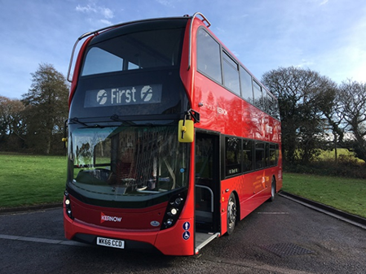
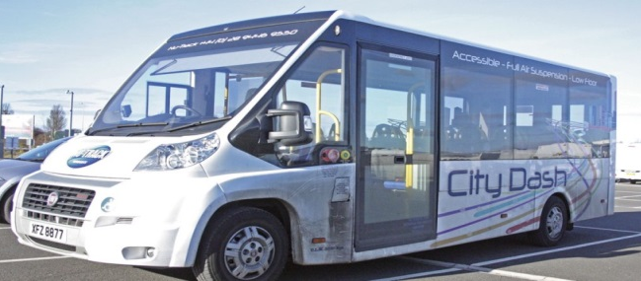
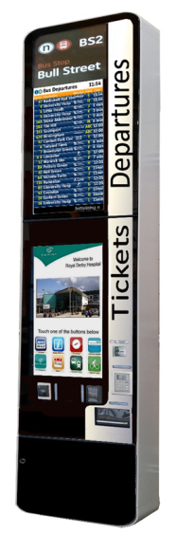
OPTSfC – Show Case Routes
Delivery
‘Showcase corridors’ identified –
T1/T2 (14/18), U1/U2/U3, 11/11A
Vehicle trials undertaken by
small operators
On street infrastructure:
  Upgrade of existing RTPI displays
  Trial of solar RTPI sign and digital timetable
  Trial of totem units
  Transport Infrastructure Design Guide approved
Notes:
In terms of delivery:
‘Showcase corridors’ have been identified for pilot schemes –14/18, U1/2, 11/11A. Operators have committed to putting new vehicles on these routes to significantly improve their appeal to the public. 30 new double deck vehicles have been purchased by First Kernow and put into service on the 14/18 (now T1/T2) and U1/U2. They have new branding, WiFi and USB charging points and lounge-style seating upstairs. In partnership with the operators we will be upgrading the infrastructure on these routes and expanding the real time information.
CC has organised and facilitated a number of small vehicle trials for operators who run them on supported services. Feedback was taken from the operators and service users on the 9 different types to vehicles trialled which will inform the forthcoming purchase strategy.
On street infrastructure –
Upgrade of existing RTPI displays
Trial of solar RTPI sign and digital timetable
Trial of totem display units (large, integrated LED displays) that will show public transport times and information
Transport Infrastructure Design Guide approved by the Transport Policy Advisory Committee in September with the aim of standardising the range and style of shelters and infrastructure

Slide 14
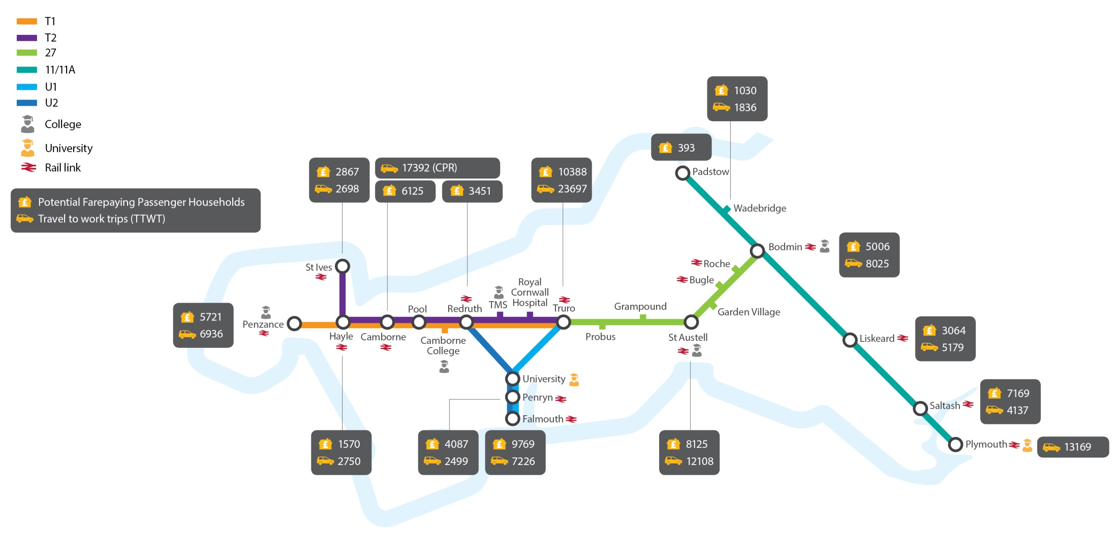
OPTSfC – Show Case Corridor
Notes:
A project Steering Group has been established and consists of representatives of:
Bus operators (commercial and SME)
Rail operator
Transport Focus
Local Transport Board
Cornwall Council
We have also established reporting mechanisms with the PAC, Cabinet, Local Transport Board, Local Enterprise Partnership and with Government through the Devolution Deal team.
An Evidence Base has been established consisting of:
Network & service review – identifying the key elements of the existing network, examination of frequency and geographical coverage
completion of the Countywide infrastructure audit, including bus and rail stations
Roadside Infrastructure audit and completion of work with town and parish councils to determine the ownership and maintenance of on-street infrastructure
Market research – workshops and surveys were undertaken with users and non users to gain a better insight into people’s understanding and satisfaction with the current network
Socio-demographic profile – using the survey results we have developed profile of existing bus users and those with the most potential to use bus services in future
On bus Origin – Destination surveys were undertaken to better understand passengers’ travel patterns and journey purpose
Development of web/GIS portal that displays the above information in a series of layers
Bus Network Plan – is underway that uses this evidence base to begin to develop the key principles if the new network

Slide 15
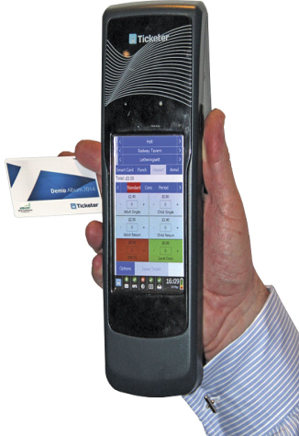
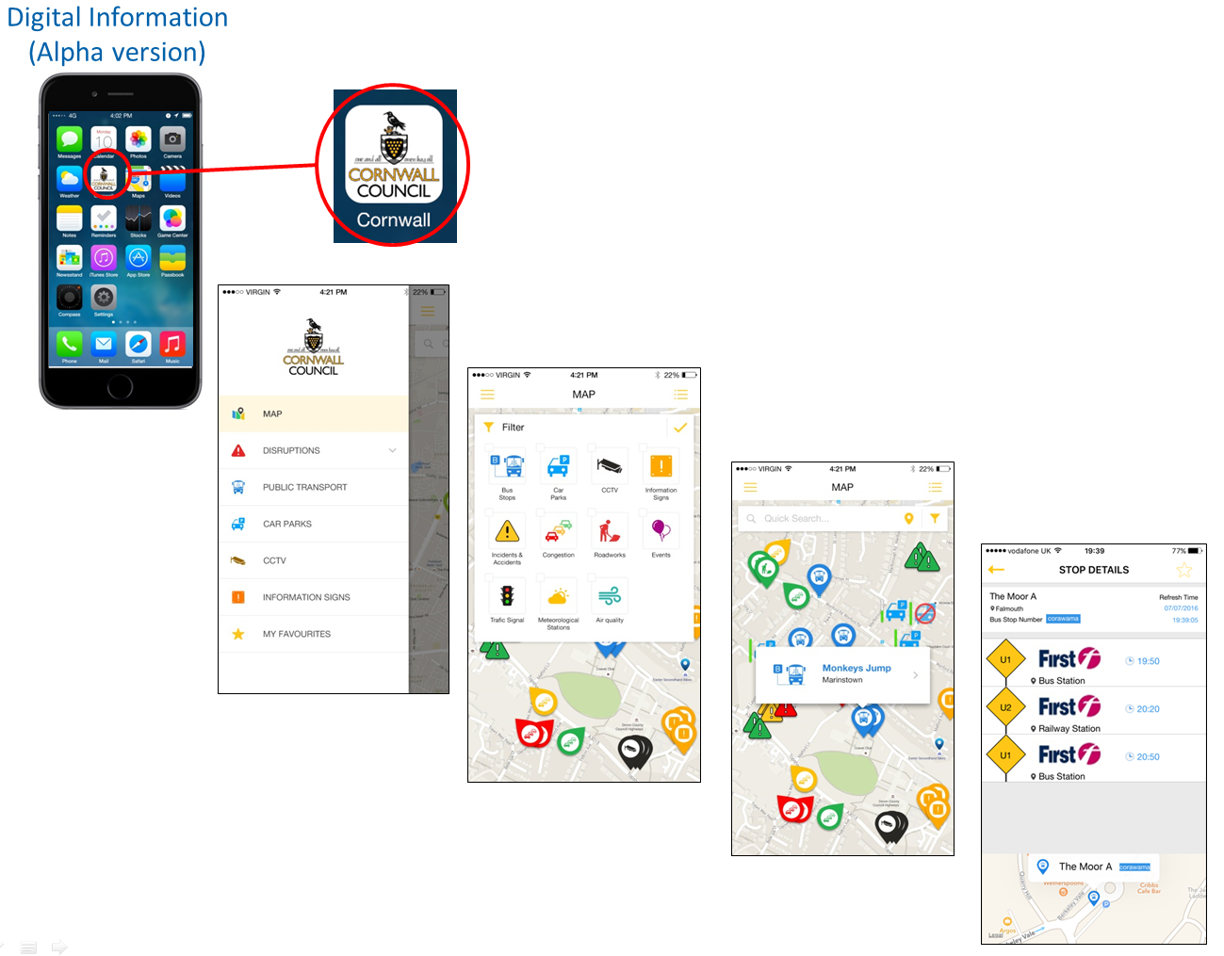
OPTSfC – Delivery of Ticketing, Technology & Brand
Cloud Amber Intelligent Transport System procured
E-ticketing trialled with Scholars
Multi-modal journey planning
app developed
Audio stop announcements
trialled
Air quality monitoring rolled
out
Stage 1 – Brand identification
completed
Notes:
Cloud Amber Intelligent Transport System procured – this is the system that will drive the communication across the network with traffic signals and vehicles, provide the real time transport feeds to on street and online displays and will collate this data to enable efficient monitoring of the network’s performance
E-ticketing trialled with Scholars at Wadebridge School – smartcard and mobile phone app (Proof of Concept)
A Transport mobile application is currently in development and will build on applications that are already available, but include Total Journey Planning for all transport modes, compare benefits for using public transport and provide offers/ discounts from local businesses.
Audio stop announcements are being trialled on the Park for Truro park and ride service
Air quality monitoring has been rolled out in identified AQMAs
Stage 1 – Brand identification completed

Slide 16
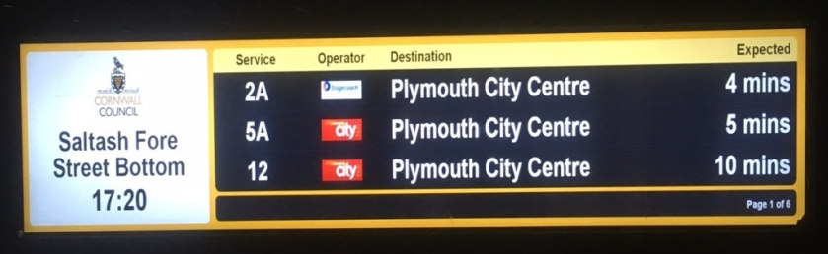
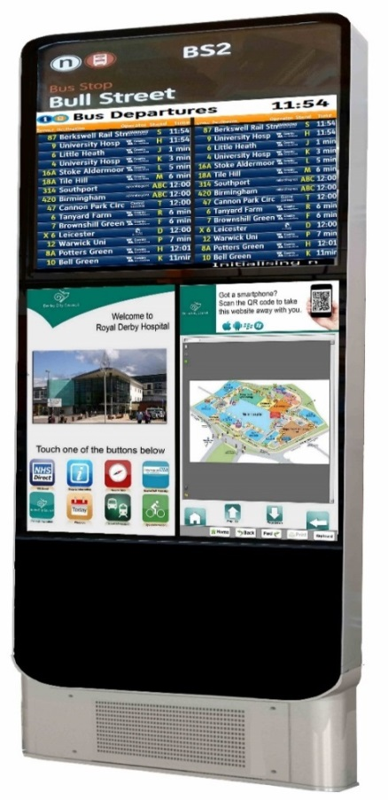
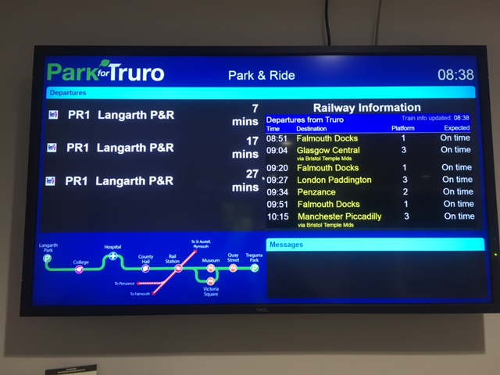
OPTSfC – Delivery – Passenger Information
Use of 28” / 19” TFT displays across network
Interactive Totems at key bus stations/interchanges
TFT summary displays located at rail/bus stations P&R, with ability to displays both bus and rail departures
Opportunity to accommodate advertising on TFT displays to offset running operational costs
Notes:
On street displays will commonly be 28” TFT display which has the ability to display 3 lines of departure information. Screens will also have the ability to accommodate service information messages e.g. to advise customers of an incident, change of route etc.
Interactive Totems, including Ticketing Totems will be strategically placed at key bus stops to provide opportunity for bus/rail integration.
TFT summary displays to be located at rail/bus stations which will have the ability to display both bus and rail live departure information.
All TFT screens will be capable of accommodating advertising for income generation to help offset operational and maintenance costs.

Slide 17
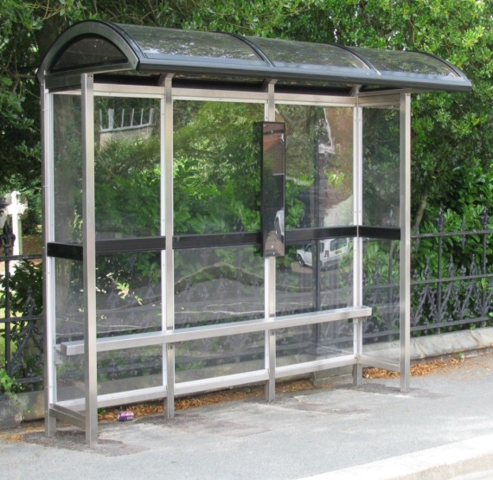
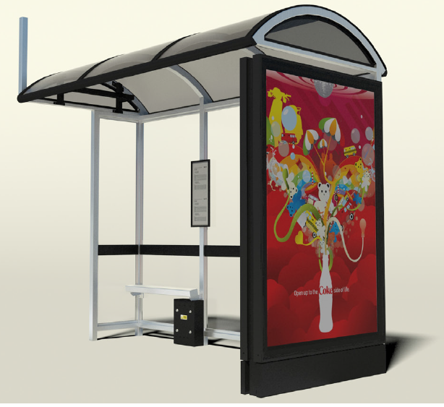
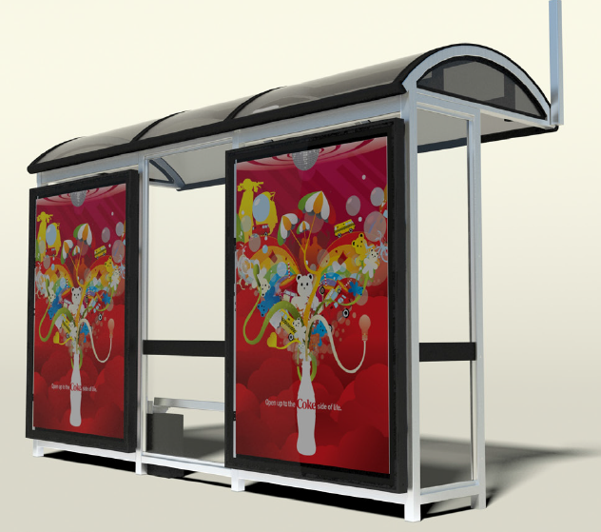
OPTSfC – Delivery – Bus Stop Standards
Standardisation of type and design of shelters on network.
Shelters to be RTPI ready for latest digital displays.
Shelters to incorporate flags and timetable cases to reduce on street furniture
Advertising panels to be fitted where appropriate for income generation.
Countywide bus shelter maintenance and cleaning programme to be established
Notes:
CC have produced a new Infrastructure Design Guide which sets out the minimum standards and the types of transport infrastructure to be used on the network.
Shelters will now commonly be constructed of stainless steel with toughened safety glass for greater longevity and ease of maintenance.
New shelters will, where required, come RTPI ready to accommodate 28” TFT displays.
Shelters will also accommodate flag brackets and timetable cases thus reducing the need for additional items of street furniture as bus stop poles.
To help ensure new assets are well looked after and maintained from installation, we will be looking for shelters to accommodate advertising panels for income generation to offset costs.
A new county wide cleaning and maintenance program is to be established which will ensure frequent cleaning and safety checks of bus shelters. An on call and response service will also be setup to tackle vandalism and restore assets.
Colour of mid rail and roof trip is customizable and can be changed (subject to agreement with PTU) to integrate with existing transport infrastrucuture.

Slide 18
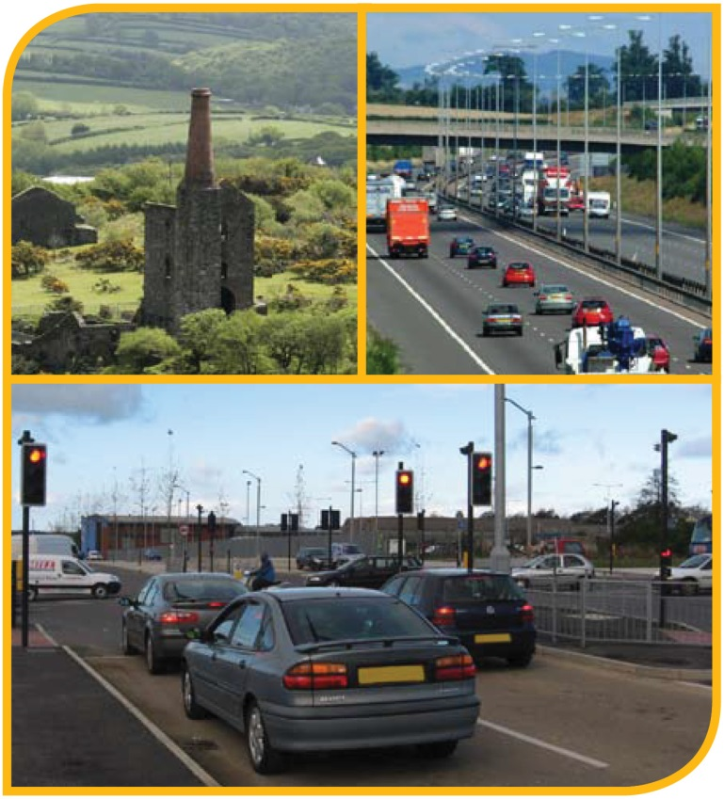
OPTSfC Customer Experience
Customer Charter
Single Point of Contact
Feedback Sessions – Focus Groups
Training courses for staff engaged on public transport
Codes of Conduct - Safeguarding – DBS checks
Improving connectivity

Slide 19
OPTSfC – Time Line
Dec 2017
Mar 2017
Jun 2017
Dec 2017
Dec 2018
Apr 2017
Sept 2016
Feb 2017
May 2017
Back Office Systems
ARGONAUT
ICARUS
JUNO
Bus Prioritisation tested Live
37 New Buses (£10.5m)
Infrastructure Assessment/ Selection
Idealistic ONE Network Stage 1
Engagement with Community Networks
Totem Ticket Terminals Ordered (TPR)
On Bus Ticket Machines Ordered
Bus Fleet Emissions Assessment
Engagement Sessions
CC Members
Town & Parish Councils
GWR/ First – Rail + Bus Ticketing
ONE Network Stage 2 Design
On Bus Contactless Transaction
Ticket Totem Commission
On Street Infrastructure Installation

Slide 20
Thank You
For
Listening email: gwilliams@cornwall.gov.uk
Cornwall Council
County Hall
Truro TR1 3AY
Tel: 0300 1234 100
www.cornwall.gov.uk

